Slide 2
【第一週英語作業】
聽: CD1(第2~4首)，每聽3遍請家長簽一次名。
背:複習Focus讀寫練習本P1~P2單字，下週開始
進行單字道館挑戰。
寫:完成Focus讀寫練習本P3~P4。

Slide 3
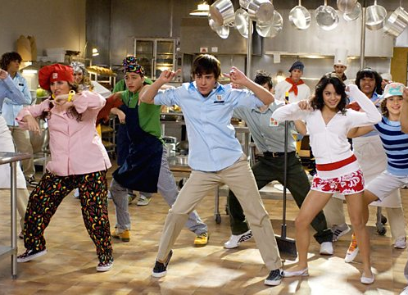
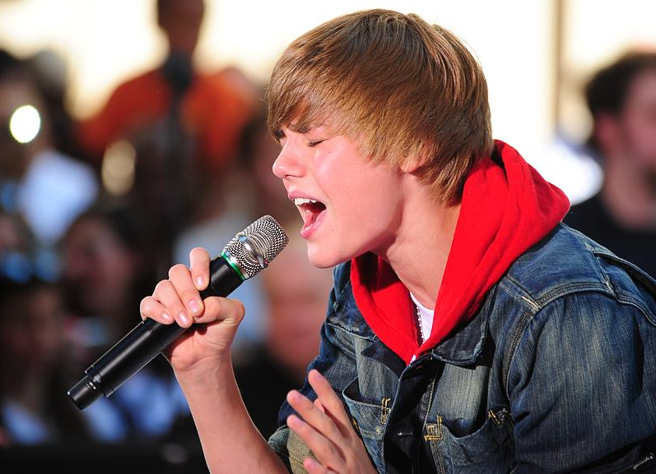
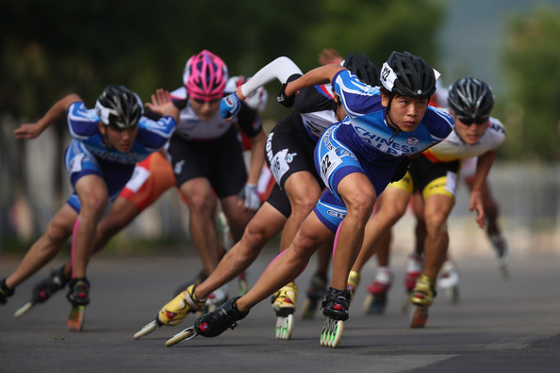
Unit 1
1
3
5
4
6
2

Slide 4
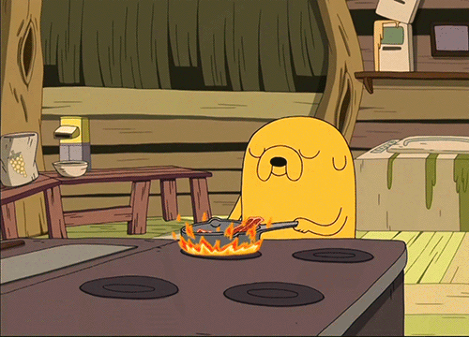
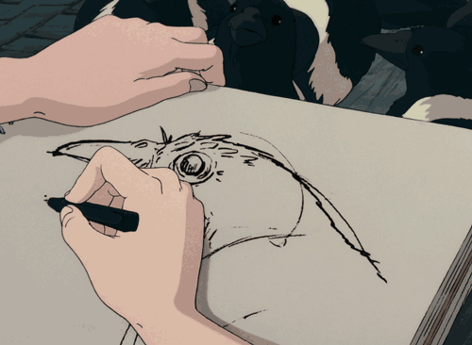
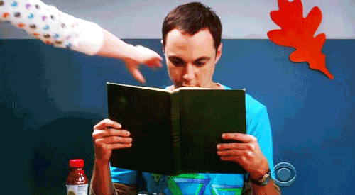
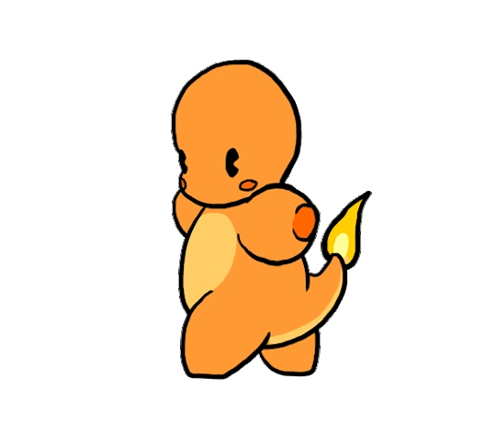
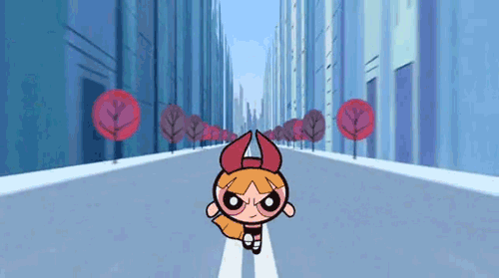
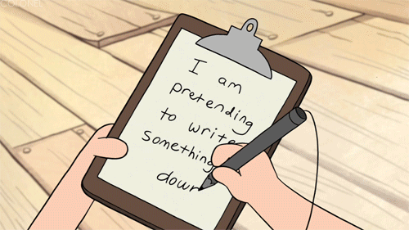
Unit 2
3
2
1
6
4
5

Slide 5
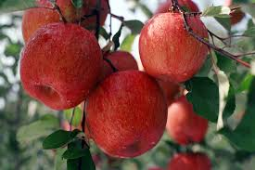
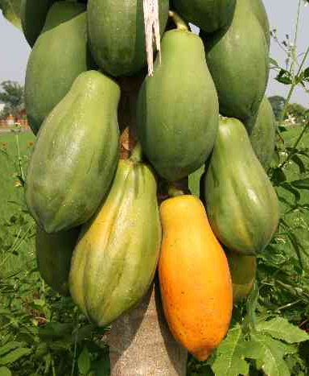
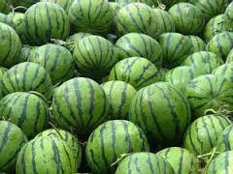
Unit 3
1
2
3
6
5
4

Slide 6
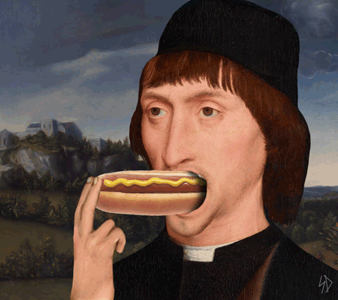
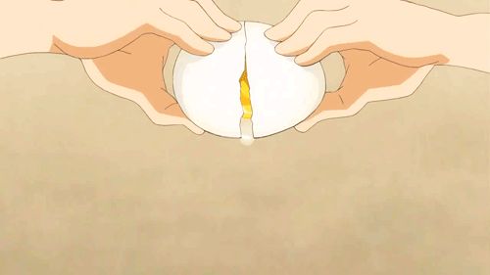
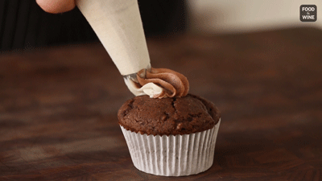
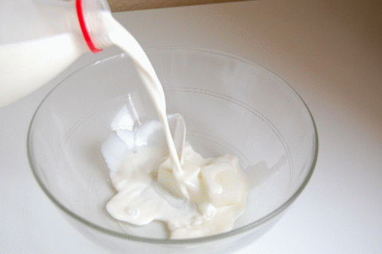
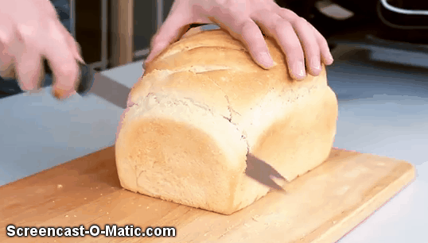
Unit 4
2
1
3
7
5
6
4

Slide 7
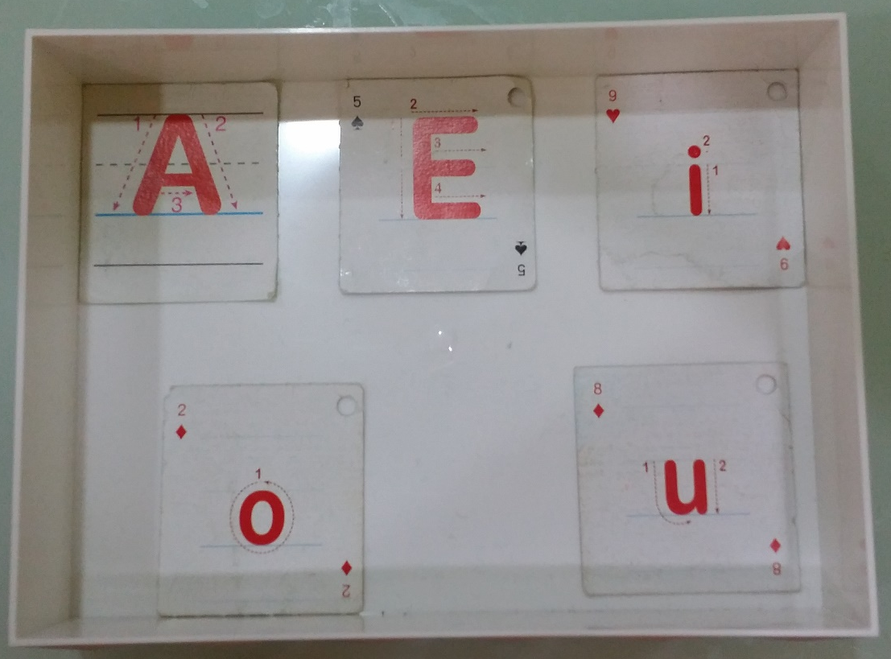
Spelling Battle
1.Each group can get one white box and a set of vowels (a/e/i/o/u).
2. Everybody takes turns to pick up 5 or 6 cards.

Slide 8
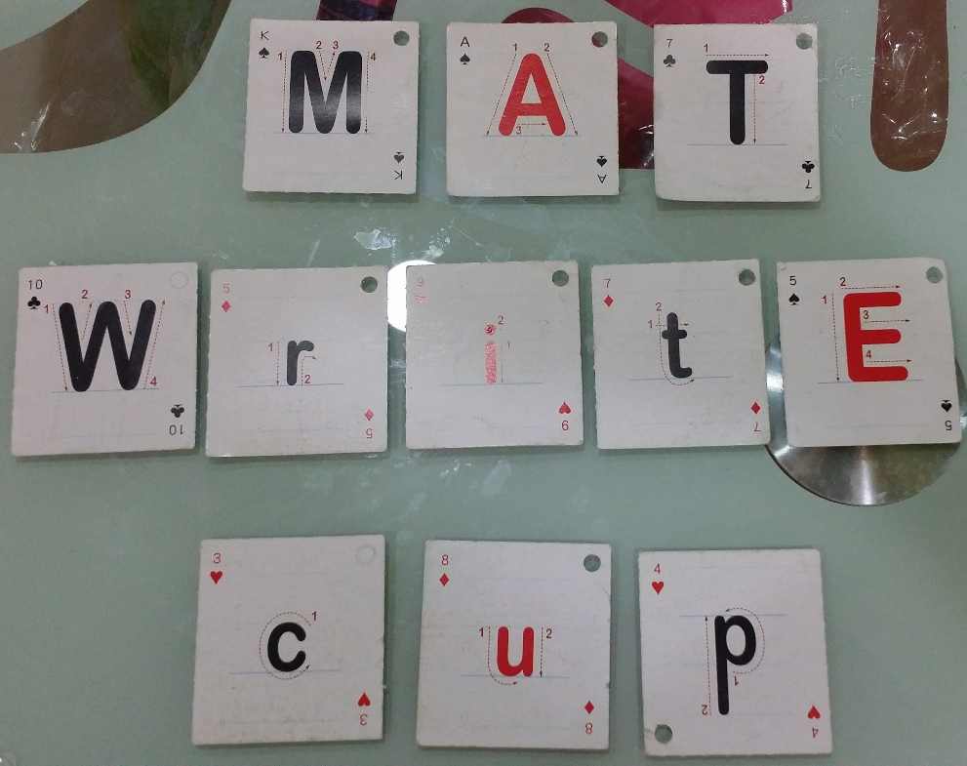
3. Whole group members use these cards to spell the words as many as possible.
4. View upper case and lower case as the same letter.

Slide 9
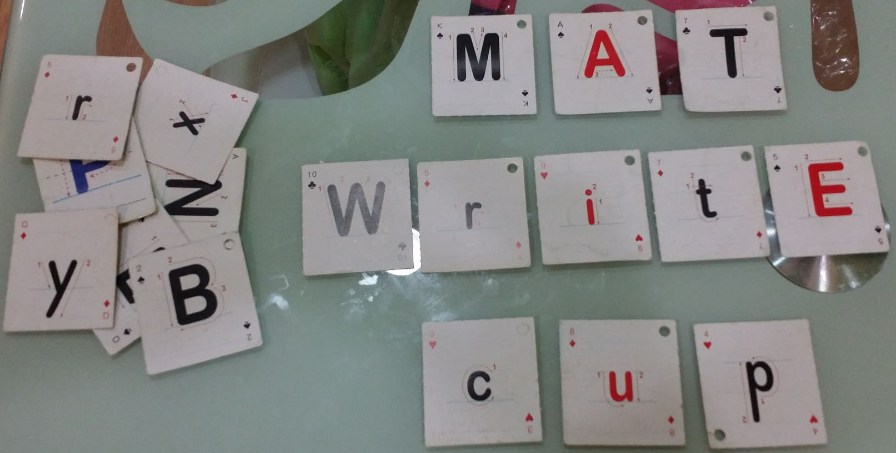
5. Time’s up! Let’s count how many scores you can get.
A whole word→ each letter counts 5 dollars.
$15
$25
No use,
No scores!
$15

